Slide 1

HMRC Exercise
By Marcos Ferreira
Notes:
Before I start, I just want to mention that in a real scenario, some decisions I made—like which tools to use, how to handle discrepancies, and which calculation methods to apply—would follow best practices, documented guidelines, or be checked with a manager. I’d also gather details on key stakeholders and decision-makers to tailor the analysis and presentation. If that being said I am now ready to start.
Good morning. My name is Marcos Ferreira, and today I’ll be presenting my analysis based on the dataset provided for this exercise.

Slide 2
Introduction & Data Overview
Purpose: Analyse company turnover trends and business incorporation data.
Dataset: Anonymised dataset covering multiple business sectors.
Key Analytical Objectives:
Identify the sectors with the greatest increase and decrease in turnover.
Break down Farming sector turnover year by year.
Determine the least common month for business incorporation.
Identify additional trends and geographic comparisons.
Notes:
This dataset has information about companies, including their turnover from 2020 to 2024, sector, status, and registration details. The analysis focused on answering four key questions, which you can see on the screen and I will answer one by one on the next slides.

Slide 3
Data Preparation & Methodology
Data Structure, Cleaning & Validation
Created a working copy with separate sheets for processing, reporting, and dashboards.
Removed ‘Summary-…’ rows to prevent double counting.
Kept blanks for missing turnover to maintain data integrity instead of assuming £0.
Created custom formulas for turnover calculations, date extraction, and data validation using Pivot Tables.
Advanced Analysis & Automation
Used Python for:
Turnover predictions for 2025 and 2026.
Automating data aggregation & calculations, reducing manual effort.
Analysing turnover trends by country (Question 4) and seasonality patterns by month and industry (Question 3).
Creating visuals (line charts) to present trends clearly.
Structuring technical reports for a transparent analysis process
Notes:
Before starting the analysis, I want to tell you how I prepared the data. I created a working copy of the dataset with separate sheets for processing, reporting, and dashboard. This way, I could manipulate the data while keeping the raw source intact.
For data cleaning, I removed the rows related to the Company Name column called ‘Summary-…’, which aggregated turnover by sector. These rows were mixed with individual company records, leading to double counting. I verified the impact of this removal using SUMIFS calculations and a comparison table to confirm accuracy.
When it came to missing turnover values, I decided not to replace them with £0, as that would distort the analysis. Instead, I kept them as blanks to preserve data integrity.
For year-on-year turnover calculations, I created custom formulas that handled missing data properly. I validated these formulas by comparing them with Pivot Tables.
Another option could have been filling blanks with sector averages using a mean calculation, but I chose to work with the raw data to keep transparency.
An important part of the methodology was the use of Python. I applied Python to predict turnover for 2025 and 2026, automate tasks like data aggregation, validate some of my findings and to generate visuals, which you will see on some slides.
Python also played a key role in the analysis process. It was used to uncover trends in turnover by country (which I’ll cover in Question 4) and to explore seasonality patterns by month and industry (relevant to Question 3).
And finally, I documented everything in a detailed technical report to ensure that all decisions, assumptions, and validations were fully transparent.
Apologies, for getting a bit more technical here but the goal of this structured approach is to ensured that all the insights I’m presenting today are based on clean, reliable, and fully validated data.

Slide 4
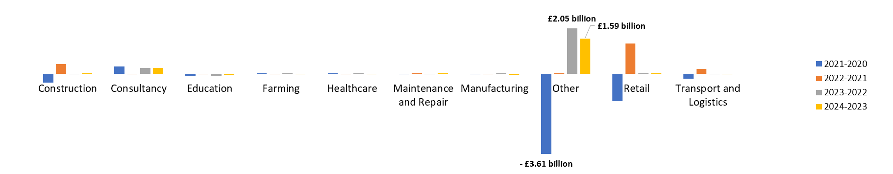
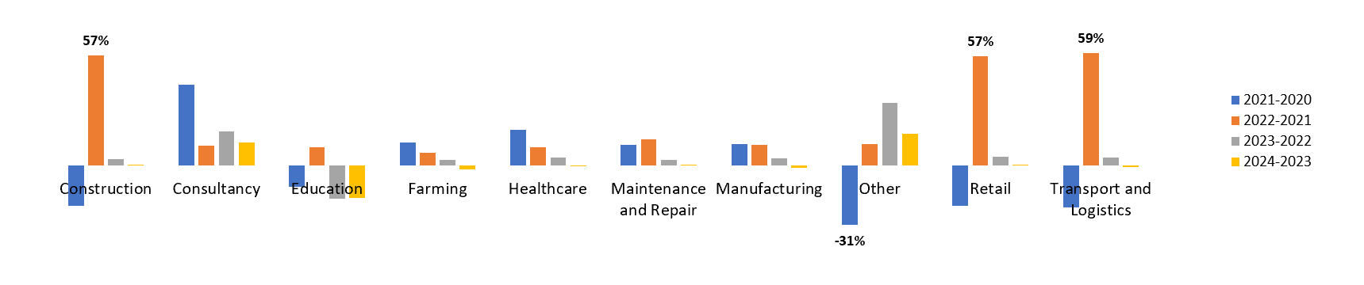
Sector Turnover Trends
Which sectors show the greatest increase and decrease in turnover over the years available?
Notes:
When looking at turnover changes, big numbers don’t always mean the biggest impact.
What I mean is: A sector with high revenue might show large monetary changes, but the real question is: how much did it actually grow or shrink compared to its size?
In the first chart on the top, showing changes in revenue, the sector ‘Other’ had the most extreme shifts. It saw the biggest drop in 2021, then in 2023, it had the biggest increase.
Retail and Construction also had large jumps and dips, making them highly volatile sectors.
However, when we look at percentage changes, we see a different picture. Construction had the biggest increase, growing 57% in 2022, bouncing back after a tough year. The biggest percentage drop was in ‘Other’ in 2021, falling by 31%.
And That’s why I chose to show both views—so we can see not just the biggest money shifts, but also the biggest real impacts on each sector.

Slide 5
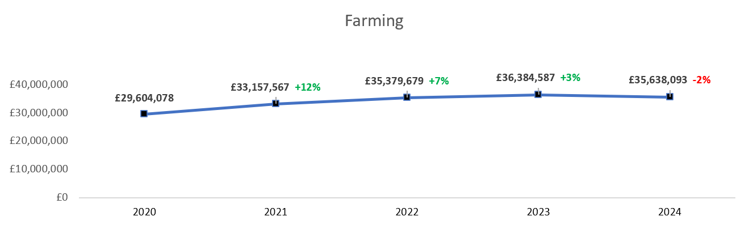
Farming Turnover Breakdown
What is the total turnover for "Farming" broken down by year?
Notes:
As you can see on the chart, the turnover for Farming started at just over £29 million in 2020 and grew to just over £35 million in 2024, with a small drop of about 2% in 2024 compared to the previous year.
So, we’ve seen solid growth overall, but a slight dip in the most recent year. If the industry keeps this 5% average growth rate, it might reach an annual turnover of £39 million in 2026

Slide 6
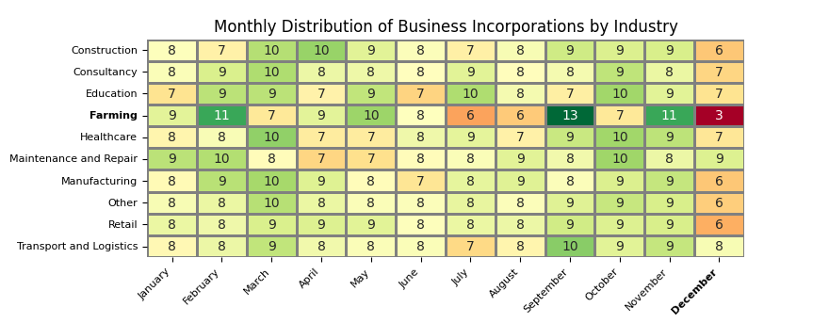
Least Common Incorporation Month
What is the LEAST common month to incorporate a business? Is this true for all Company Types?
Notes:
Looking at the top line chart, we can see that December is the least common month for opening a business, with only 6.5% of incorporations.
Now on this second chart, called heatmap, will have the distribution by percentage for each industry. Green means higher percentage of incorporations on that month, red means the opposite.
If we look at the last column, December, we can see that indeed less companies open a business in December but that is not the case for all. Maintenance & Repair and Transport & Logistics, opening a business in December is not unusual.
Farming stands out the most—not only is December by far its lowest incorporation month, but it’s also one of the most volatile industries overall, with sharp spikes of reds and greens throughout the year.
From September to November, it’s common to see incorporations on the Retail sector. The expectation of high sales during Christmas period might be an explanation.

Slide 7
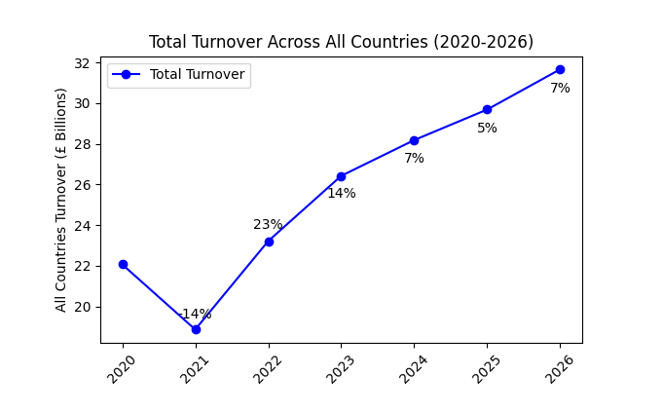
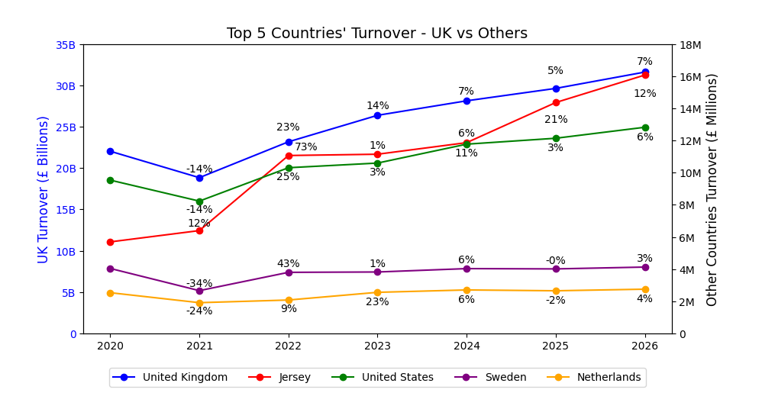
Additional Trends & Insights
What other conclusions can be drawn from the data?
Notes:
This final section highlights additional trends and insights from the data.
Looking at the first chart, we see the total turnover for all countries from 2020 to 2026. The sharp drop in 2021 was likely due to COVID, but turnover recovers steadily, with 2025 and 2026 projected based on past trends.
The second chart compares the UK against the other top 4 countries. Whie UK turnover is in Billions, as you can see on this blue line, the other top countries are in Millions, it makes the UK be considered an outlier on this dataset. Which means that to to get a better picture, it’s better to focus on the other countries separately.
A first interesting fact is that, the United States follows a similar trend to the UK, with a drop in 2021 but a steady recovery in the following years.
A second interesting fact is that in this dataset there are only two companies from Sweden, but Sweden still made it to the top 5.
That concludes my analysis—thank you, and I’m happy to take any questions

Slide 8
Questions & Answers
Thank You

